Slide 2
Partnership for Assessment of Readiness for College and Careers (PARCC)
Notes:
TALKING POINTS
PARCC is an alliance of 24 states, educating nearly 25 million students, that are working together to develop a common set of K-12 assessments in English and math anchored in what it takes to be ready for college and careers. PARCC is led by 17 governing board states (and D.C.) represented in Dark Blue.
CLICK: The chair of the governing board is Mitchell Chester, Education Commissioner of Massachusetts, and the state of Florida is serving as its fiscal agent.
CLICK: Achieve is the project manager for PARCC, essentially serving as the staff for the consortium and coordinating the work. Collectively the PARCC states educate nearly 25 million students.
Governing States will pilot and field test the assessment system components over the next three years and administer the new assessment system during the 2014-15 school year. Governing States will use the results from the PARCC assessments in their state accountability systems
The chief state school officers of the Governing States serve on the PARCC Governing Board and make decisions on behalf of the Partnership on major policies and operational procedures
Participating States (light blue) provide staff to serve on PARCC’s design committees, working groups, and other task forces established by the Governing Board to conduct the work necessary to design and develop PARCC’s proposed assessment system. By 2014–15, any state that remains in PARCC must commit to statewide implementation and administration of the Partnership’s assessment system Any PARCC Participating State prepared to make the commitments and take on the responsibilities of a Governing State can become one
NOTES
Governing Board: Comprised of K-12 chiefs from Governing Board States
Technical Advisory Committee: Comprised of state/national assessment experts
Leadership Team: Comprised of delegates of K-12 chiefs from Governing Board States (e.g., Assoc. Supt for Curriculum, Assessment and/or Instruction)
ACCR: Comprised of national and state postsecondary leaders
Operational Working Groups: Comprised of national, state, and local experts and leaders in their specific areas of expertise

Slide 3
The PARCC Goals
Create high-quality assessments
Build a pathway to college and career readiness for all students
Support educators in the classroom
Develop 21st century, technology-based assessments
Advance accountability at all levels
Build an assessment that is sustainable and affordable

Slide 4
Create high-quality assessments
2 Optional Assessments/Flexible Administration
Diagnostic Assessment
Early indicator of student knowledge and skills to inform instruction, supports, and PD
Non-summative
Mid-Year Assessment
Performance-based
Emphasis on hard-to-measure standards
Potentially summative
Performance-Based
Assessment (PBA)
Extended tasks
Applications of concepts and skills
Required
End-of-Year
Assessment
Innovative, computer-based items
Required
Speaking And Listening Assessment
Locally scored
Non-summative, required
Notes:
PARCC states are developing an assessment system comprised of four components. Each component will be computer-delivered and will leverage technology to incorporate innovations.
Two summative, required assessment components designed to
Make “college- and career-readiness” and “on-track” determinations
Measure the full range of standards and full performance continuum
Provide data for accountability uses, including measures of growth
Two interim, optional assessment components designed to generate timely information for informing instruction, interventions, and professional development during the school year
In English language arts/literacy, an additional required, non-summative component will assess students’ speaking and listening skills

Slide 5
Support Educators in the Classroom
Model Content Frameworks
Support implementation of the CCSS; support development of assessment blueprints; provide guidance to state, district- and school-level curriculum leaders in the development of aligned instructional materials.
www.parcconline.org
Model Instructional Units
Item and Task Prototypes
Develop models of innovative, online-delivered items and rich performance tasks proposed for use in the PARCC assessments. www.parcconline.org
Model Instructional Units
Notes:
Model Content Frameworks:
The Model Content Frameworks for English language arts/Literacy (ELA/literacy) and Mathematics aim to serve as a bridge between the standards and the PARCC assessments.
The Model Content Frameworks are voluntary and are not intended to be curricula or scopes and sequences. Rather, they provide further articulation of the key shifts in the CCSS and their connection to the PARCC assessment system. The frameworks can be useful to states and districts as they engage in professional development and in their own curricular development efforts.
The Model Content Frameworks were developed through a collaborative state-led process that included mathematics and ELA/literacy content experts in PARCC member states and members of the Common Core State Standards writing team; PARCC helped manage this process. The development process included three rounds of review, including a public review in which about two-thirds of the nearly 2,000 comments were submitted by K-12 educators.
PARCC Item and Task Prototypes
The primary purpose of sharing item and task prototypes is to provide information and to support educators as they transition to the CCSS and the PARCC assessments. The dynamic, online prototypes presented on the PARCC website are designed to shine a light on important elements of the CCSS and to show how critical content in the standards may be manifested on PARCC’s next-generation, technology-based assessments.
The PARCC sample items and tasks can and should be viewed as one of the many types of materials educators can use during the transition to the CCSS and PARCC.
In addition to educators, students and parents may also find the sample items and tasks to be a useful resource for learning more about the CCSS and how state assessments may appear in the future.
The prototypes provided to date represent just a beginning to the complement of items and tasks that will be shared over time to represent the full range of assessment tasks that will be included on actual PARCC assessments beginning in 2014-2015. Additional prototypes and rubrics will be added over the coming months to paint a more complete picture of the PARCC assessment design in each content area and grade level.

Slide 6
Develop 21st Century, Technology-Based Assessments
PARCC’s assessment will be computer-based and leverage technology in a range of ways:
Item Development
Develop innovative tasks that engage students in the assessment process
Administration
Reduce paperwork, increase security, reduce shipping/receiving & storage
Increase access to and provision of accommodations for SWDs and ELLs
Scoring
Make scoring more efficient by combining human and automated approaches
Reporting
Produce timely reports of students performance throughout the year to inform instructional, interventions, and professional development

Slide 7
ELA/Literacy Task Types
ELA/Literacy
PBA: Prose Constructed Response (PCR)
EOY: Evidence-Based Selected Response (EBSR)
EOY: Technology Enhanced Constructed Response (TECR)

Slide 8
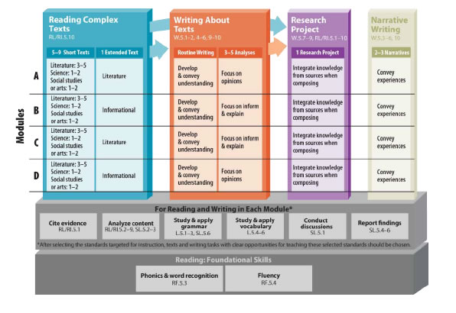
PARCC Model Framework ELA Grade 5

Slide 9
Mathematics Task Types
Mathematics
Type I (PBA and EOY): Machine scorable, focusing on major content and/or fluency. Could be practice forward.
Type II (PBA): Hand scored (or machine scored if innovative); focused on expressing reasoning.
Type III (PBA): Hand scored (or machine scored if innovative); focused on modeling/application.
Notes:
Overview of two summative assessment components:
Performance-Based Assessment:
Administered as close to the end of the year as possible
Will include essays and other high-quality, complex items.
End-of-Year:
Computer-scored, but would be far from the traditional “multiple choice” tests.
There will be multistep problems and tasks that students must complete in order to find the correct answer.
Overview of formative components:
Early Assessments:
Designed to be administered close to the beginning of the year.
Will provide an early snapshot of achievement knowledge and skills so that educators can tailor instruction, supports for students, and professional development to meet students’ needs.
Mid-Year Assessment:
Designed to be administered near the middle of the school year.
Performance-based
Will focus on hard-to-measure standards in the CCSS
Teachers could score this assessment to get quick feedback on student learning relative to the CCSS.
These components are:
are formative assessments
are developed by PARCC with its grant funds
are available to all PARCC states and their local districts
are intended to be administered early and midway through the school year
however, allow for flexible administration-- they can be administered at locally determined times, including at the discretion of the classroom teacher
can be scored quickly -- some can be computer administered and scored, others can be scored by the classroom teacher -- so that teachers can have timely information that can inform instruction for their students

Slide 10
Claims Driving Design: Mathematics
Students are on-track or ready for college and careers
Students solve problems involving the major content* for their grade level with connections to practices
Student demonstrate fluency in areas set forth in the Standards for Content in grades 3-6
Students solve problems involving the additional and supporting content* for their grade level with connections to practices
Students express mathematical reasoning by constructing mathematical arguments and critiques
Students solve real world problems engaging particularly in the modeling practice
*See PARCC Model Content Frameworks for details
Notes:
There are five sub-claims as identified for the Math assessments.

Slide 11
Prototype Item Discussion
1. What about the prototype items is surprising? What about them is exactly as you expected?
2. How can your school use the prototype items to assist teachers with instructional planning?

Slide 12
Oklahoma Assessment Transition

Slide 13
Effective Instruction
C3Standards
Effective Instruction
TLE
Notes:
Once standards are in place and understood, then we turn our focus to instruction that best supports those standards. The C3 standards were designed to prepare students for college, career and citizenship. The skills necessary to fulfill those requirements need to be built in to daily instruction.

Slide 14
Notes:
Discuss Bill Dagget’s work with the Center For Educational Research and their rigor/relevance matrix. Divide group into two and assign them to locate on their TLE every place that higher order thinking (yellow) and relevancy (green) or making cross-disciplinary connections are seen. Share.

Slide 15
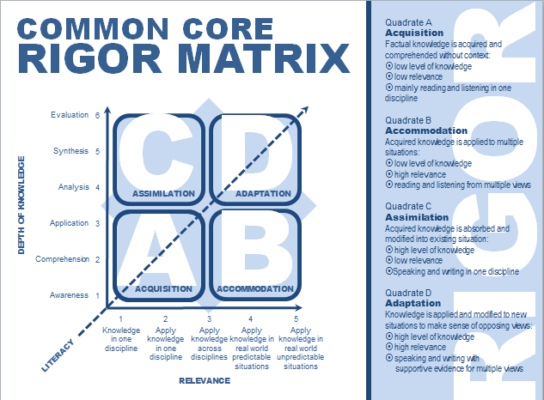
Listening-Reading-Speaking-Writing-Research/Inquiry
Notes:
Higher order thinking and relevancy might be enough if, and this is a BIG IF, literacy was not such a huge component of Common Core. Literacy has been added across disciplines as a fundamental instructional component. So if we add Literacy to the Rigor Matrix, we have a pretty good description of what we should see in Common Core Instruction.

Slide 16
Mingle (Elementary)

Slide 17
Data Sets (Secondary)

Slide 18
Questions
Evaluations
Visit http://reachcommoncoreweebly.com
K20 Alt
Teaching Channel

